Slide 1

BIGBASKET ANALYSIS
SPRINT 1:
Project Topic : BigBasket Analysis
Group 5

Slide 2
CONTENTS
1. Introduction
2. Technology Used
3. Project Flow
4. Steps Involved

Slide 3
INTRODUCTION
Bigbasket is the largest online grocery supermarket in India. Was launched somewhere around in 2011 since then they've been expanding their business. Though some new competitors have been able to set their foot in the nation such as Blinkit etc. but BigBasket has still not loose anything thanks to ever expanding popular base and their shift to online buying.
OBJECTIVE
Development of a Analysis of Big Basket Product Hierarchy.

Slide 4


TECHNOLOGY USED:

Slide 5
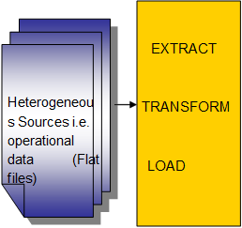
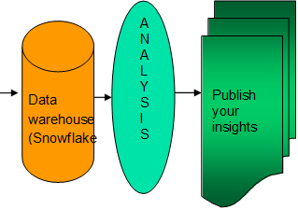
Project flow

Slide 6
Step 1: Step 2:
We Created an External Stage to load the data from the S3 bucket
We created a table and loaded the data into it

Slide 7
Step 3: Step 4:
We created a scheduler (12 AM every Thursday)
We Created Snowpipe for auto ingestion of new record sets

Slide 8
Step 5: Step 6:
We Implemented SCD 2 in for the above data flow
We implemented row level, column level security on the given dataset

Slide 9
Thank You!!

